Slide 1
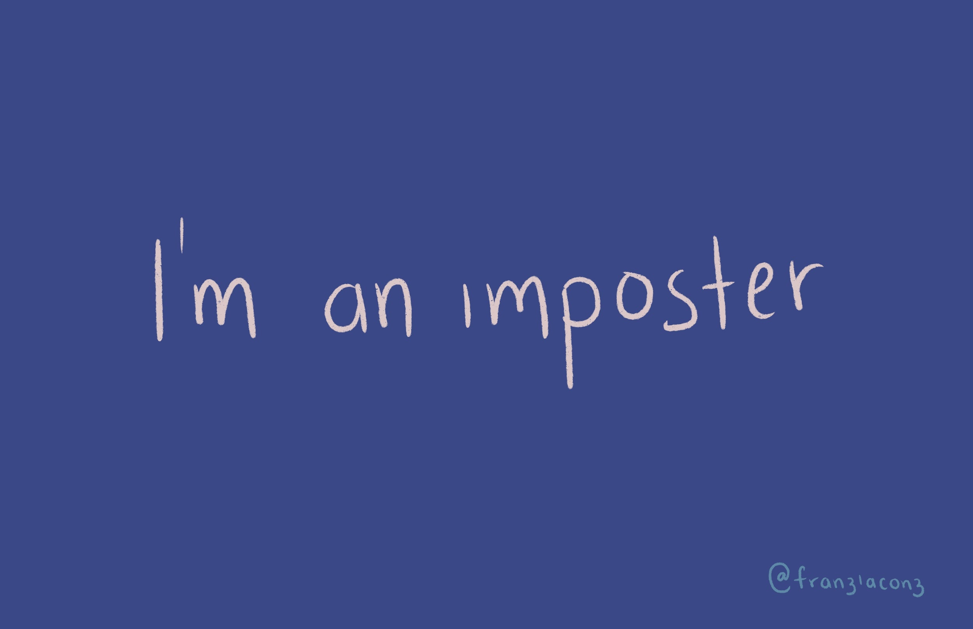

Slide 2
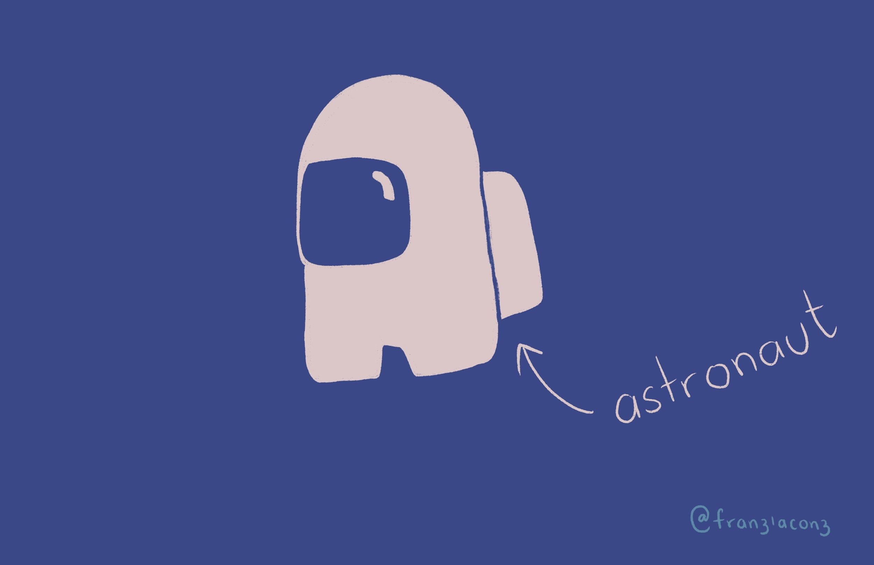
Notes:
I’ll try to be funny but remember this is my second language, so it can get messy and I can blow everything up.
So, I’m not an impostor, really. Maybe some of you understand this reference, some others don’t but this is a “childs” game (note how I put quotes in child cause im guilty of playing it). So, in this game, there’s a crew of astronauts or something similar, but there’s someone who is an impostor. That person is not an astronaut, he is a fraud.
So… I bet some of you have felt this way. Like everyone else is doing great and somehow you may not be quite prepared to be part of a team.
This is what I’m going to be presenting today, a reflection and compilation of funny moments -hopefully moments that some of you can relate to- that have happened to me and my impostor syndrome.

Slide 3
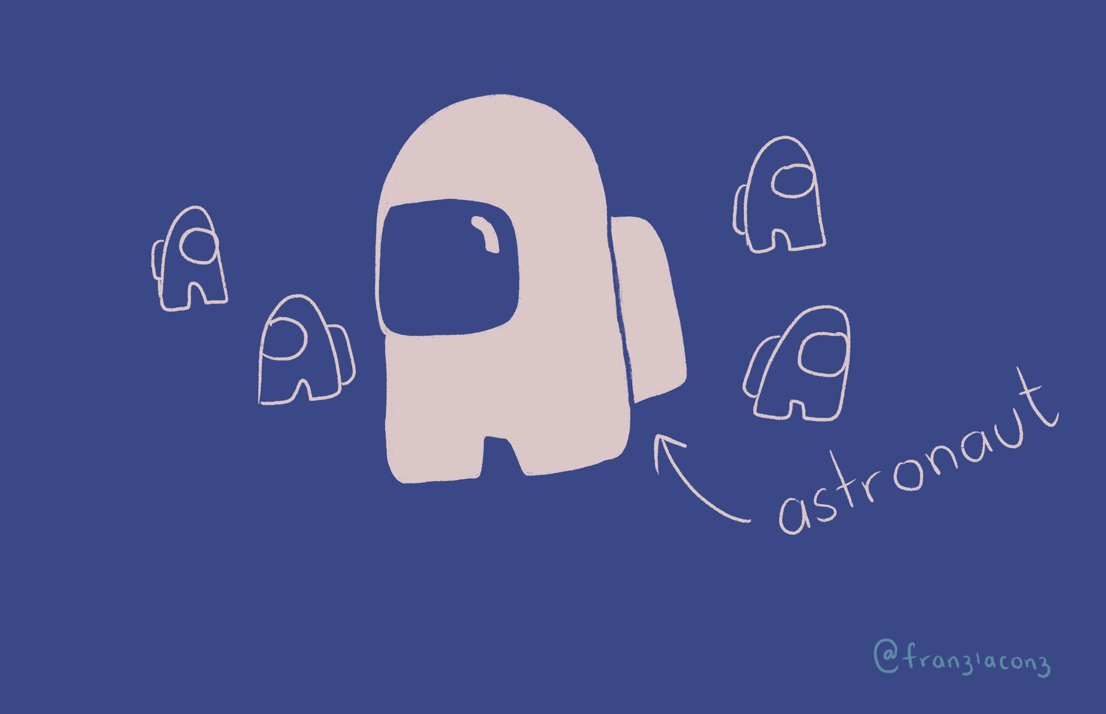
Notes:
Due to the complexity of the problems we’re solving. We’re solving for something different every time.

Slide 4

Notes:
Women often are asked to support their point with evidence. That doesn’t happen too often for men.
tl;dr high achieving minorities suffer from it.

Slide 5
Notes:
Women often are asked to support their point with evidence. That doesn’t happen too often for men.
tl;dr high achieving minorities suffer from it.

Slide 6

Notes:
My first job writing - I thought I couldn’t write. I took the offer because I thought I could make an impact, company seemed cool.
My manager at the time pushed me to go for it.
I thought I couldn’t write - after 5 years studying communications and writing freaking long and conscoius essays. I still thought I couldn’t write good articles.
It terrified me to have a blank page at first.
---
I held the record for the most visited articles for over a year.

Slide 7
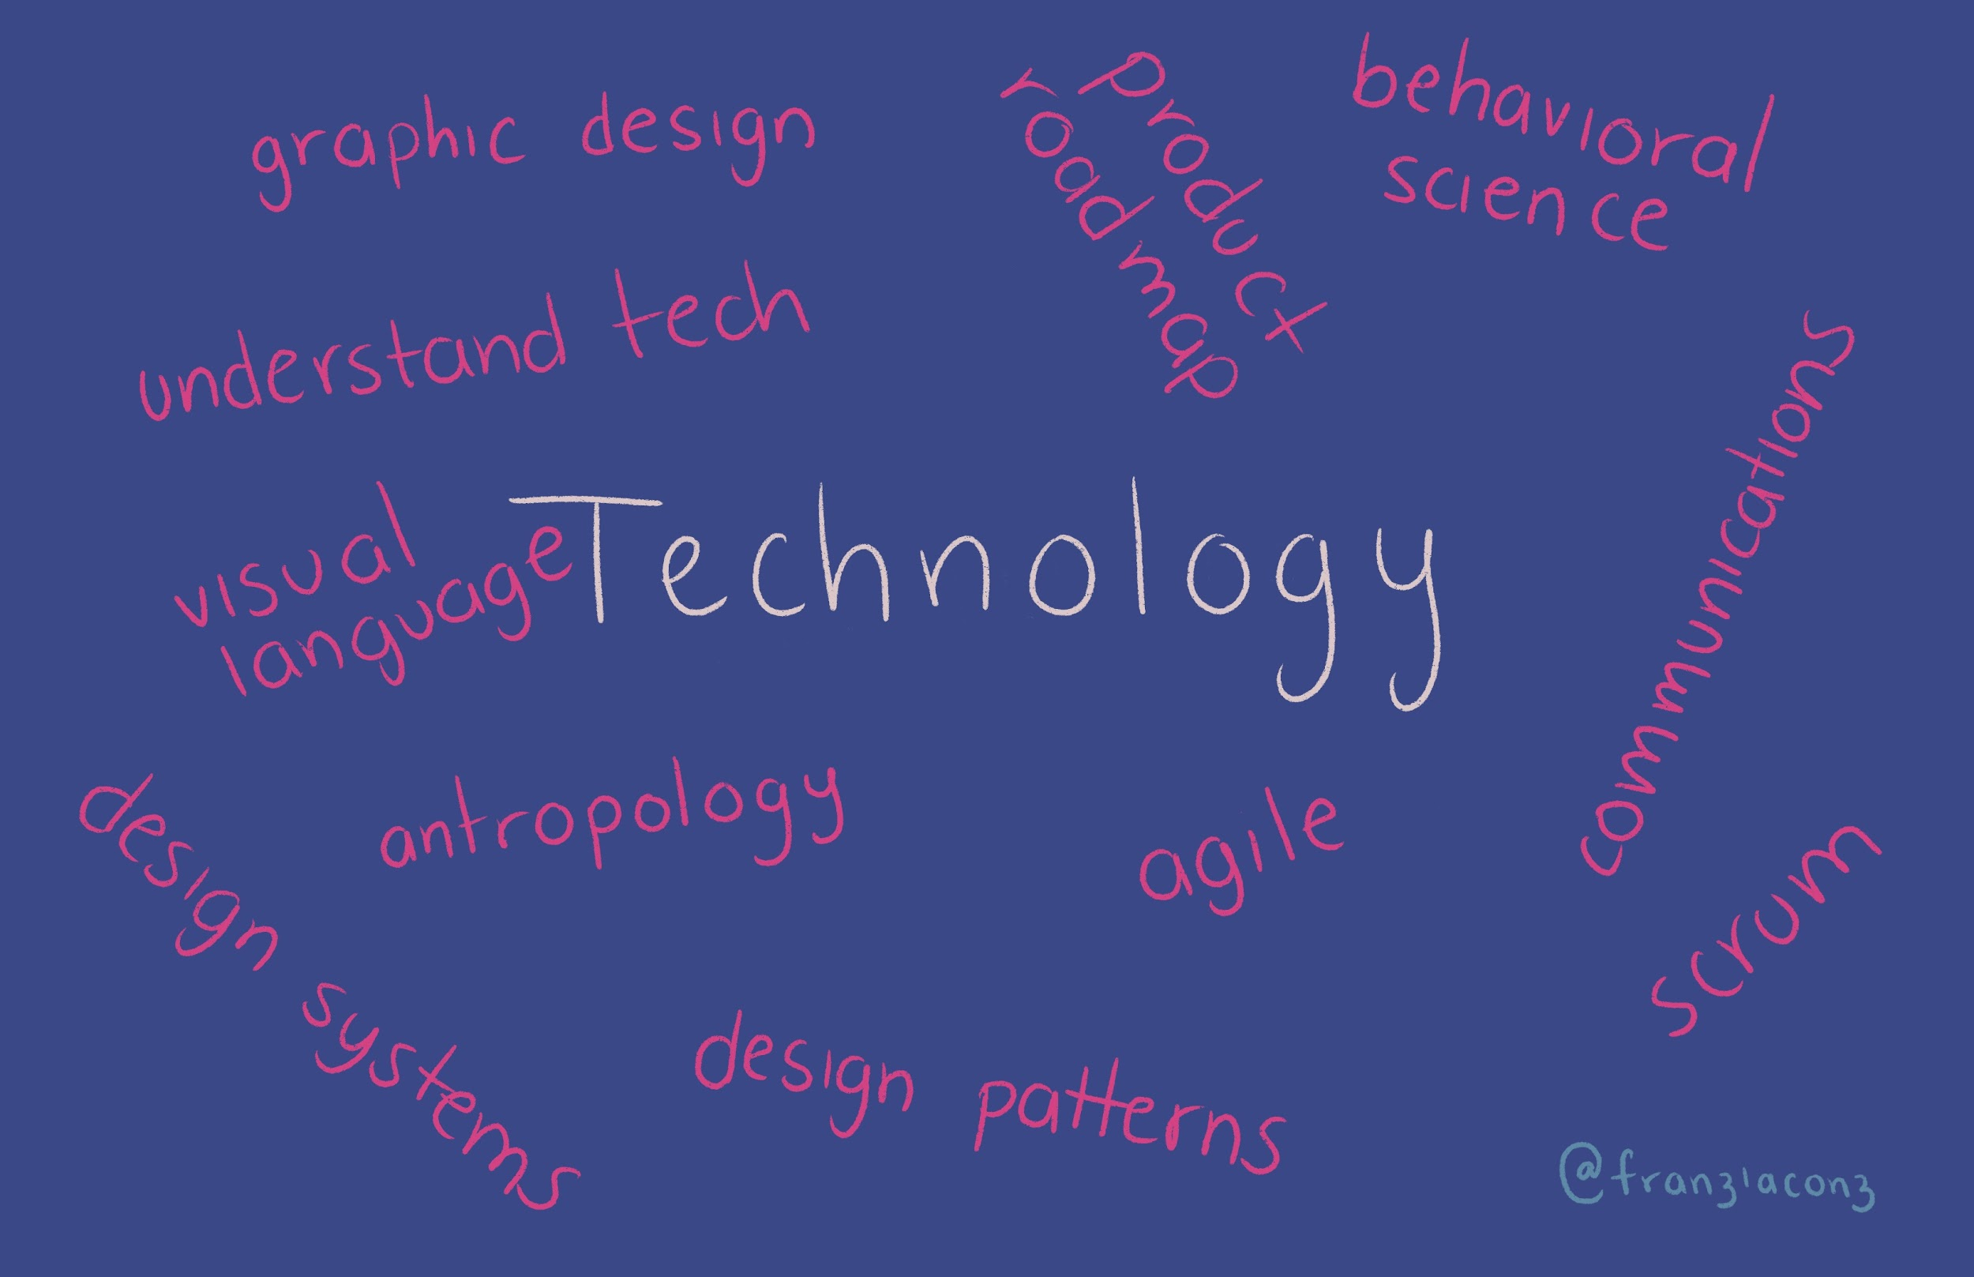
Notes:
You’re going to be building an app.
Simple app, project management. I was hesitant to do it.

Slide 8
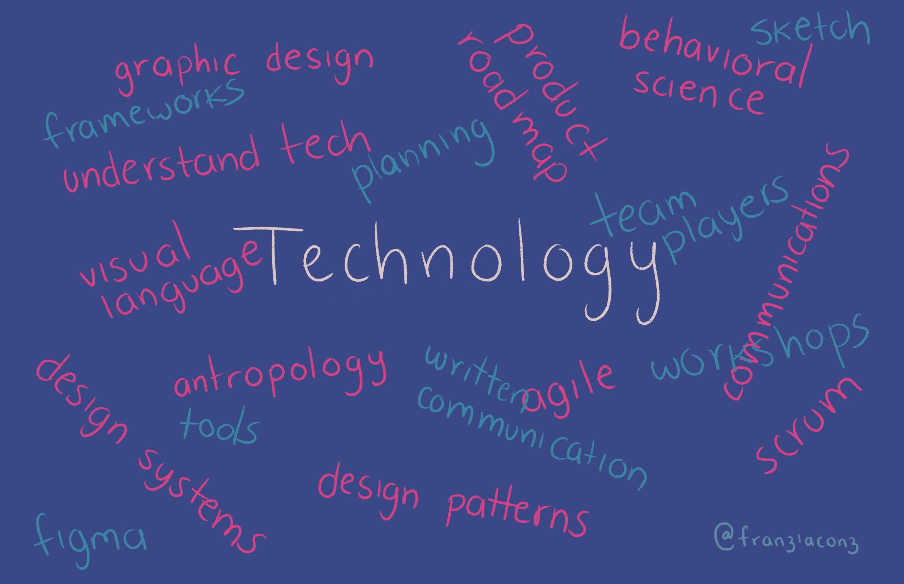
Notes:
I had a client who wasn’t evangelised as why UX adds value to the company, product or whatever.
My work was constantly challenged: why does it take you so long? what do you have to do that “research” thing? I don’t see any value in design thinking.
This could happen to anyone. Wasn’t me, was the client.

Slide 9
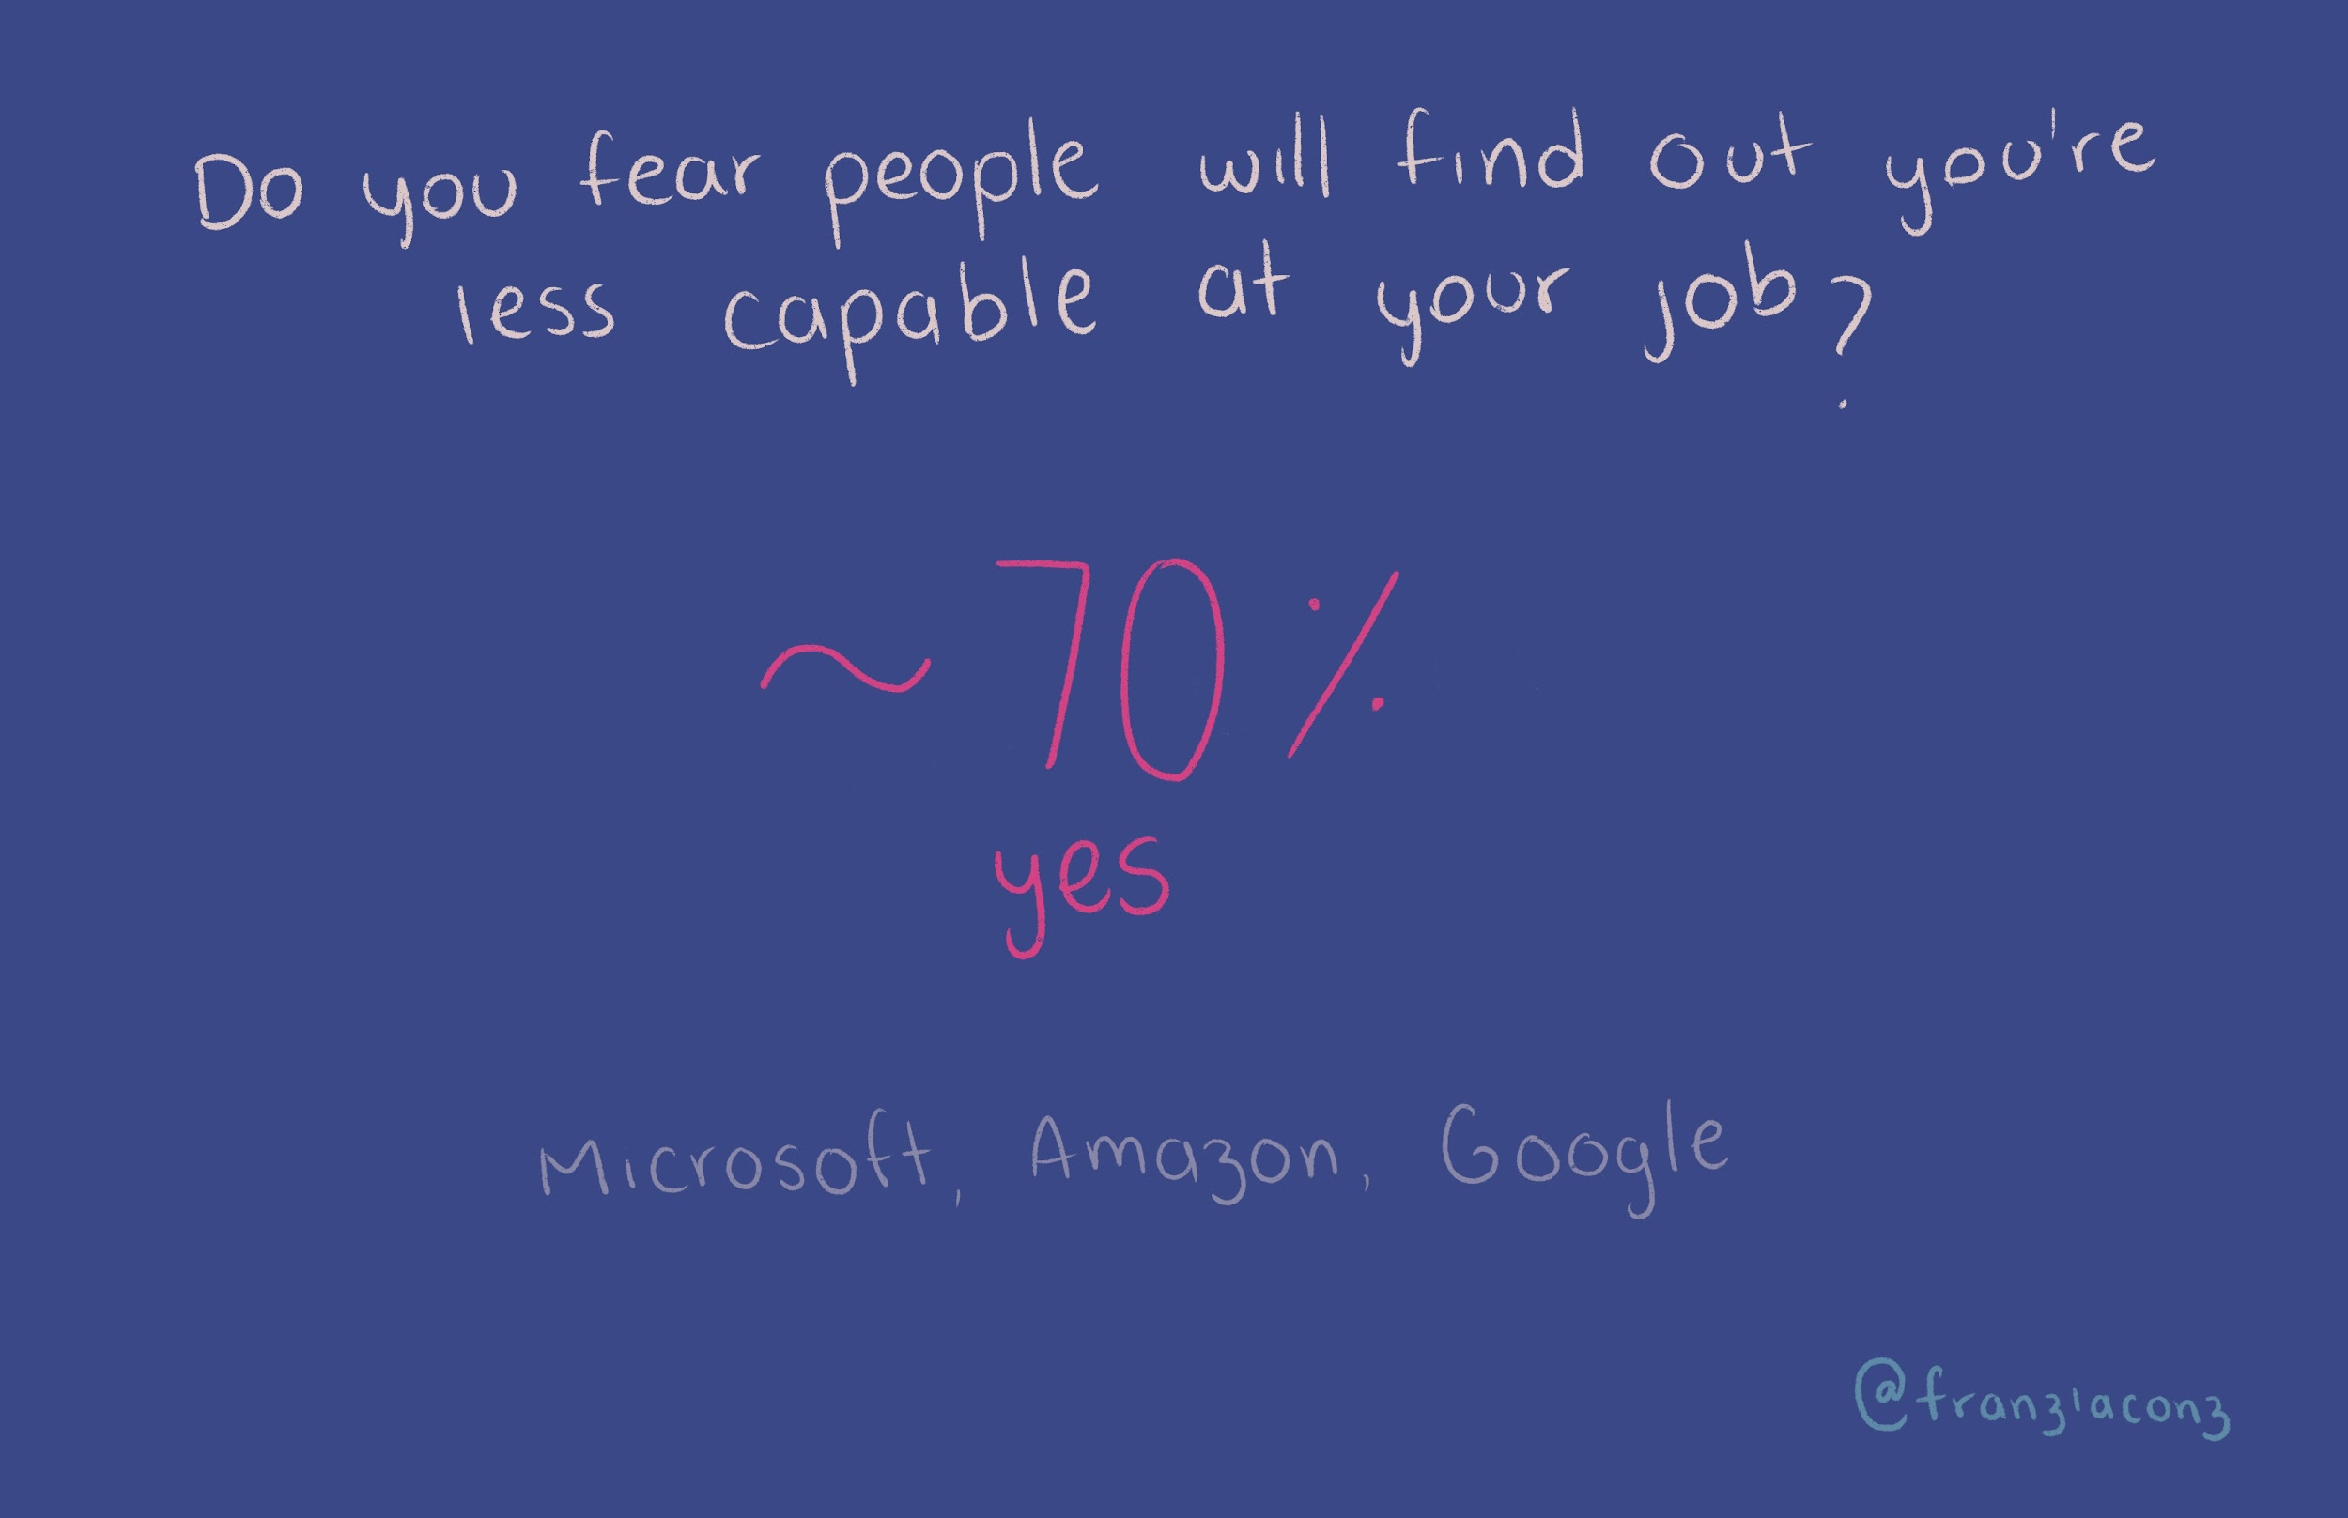
Notes:
There’s a bunch of talented people. I’m not as good.
Intimidating clients - do you guys work with Microsoft? How did I even got here? You hired me by mistake.
Praised for my first project. Then the second, then the third.
Hey, yes, there’s room for improvement, but there’s still some things to be praised.

Slide 10
Notes:
There’s a bunch of talented people. I’m not as good.
Intimidating clients - do you guys work with Microsoft? How did I even got here? You hired me by mistake.
Praised for my first project. Then the second, then the third.
Hey, yes, there’s room for improvement, but there’s still some things to be praised.

Slide 11
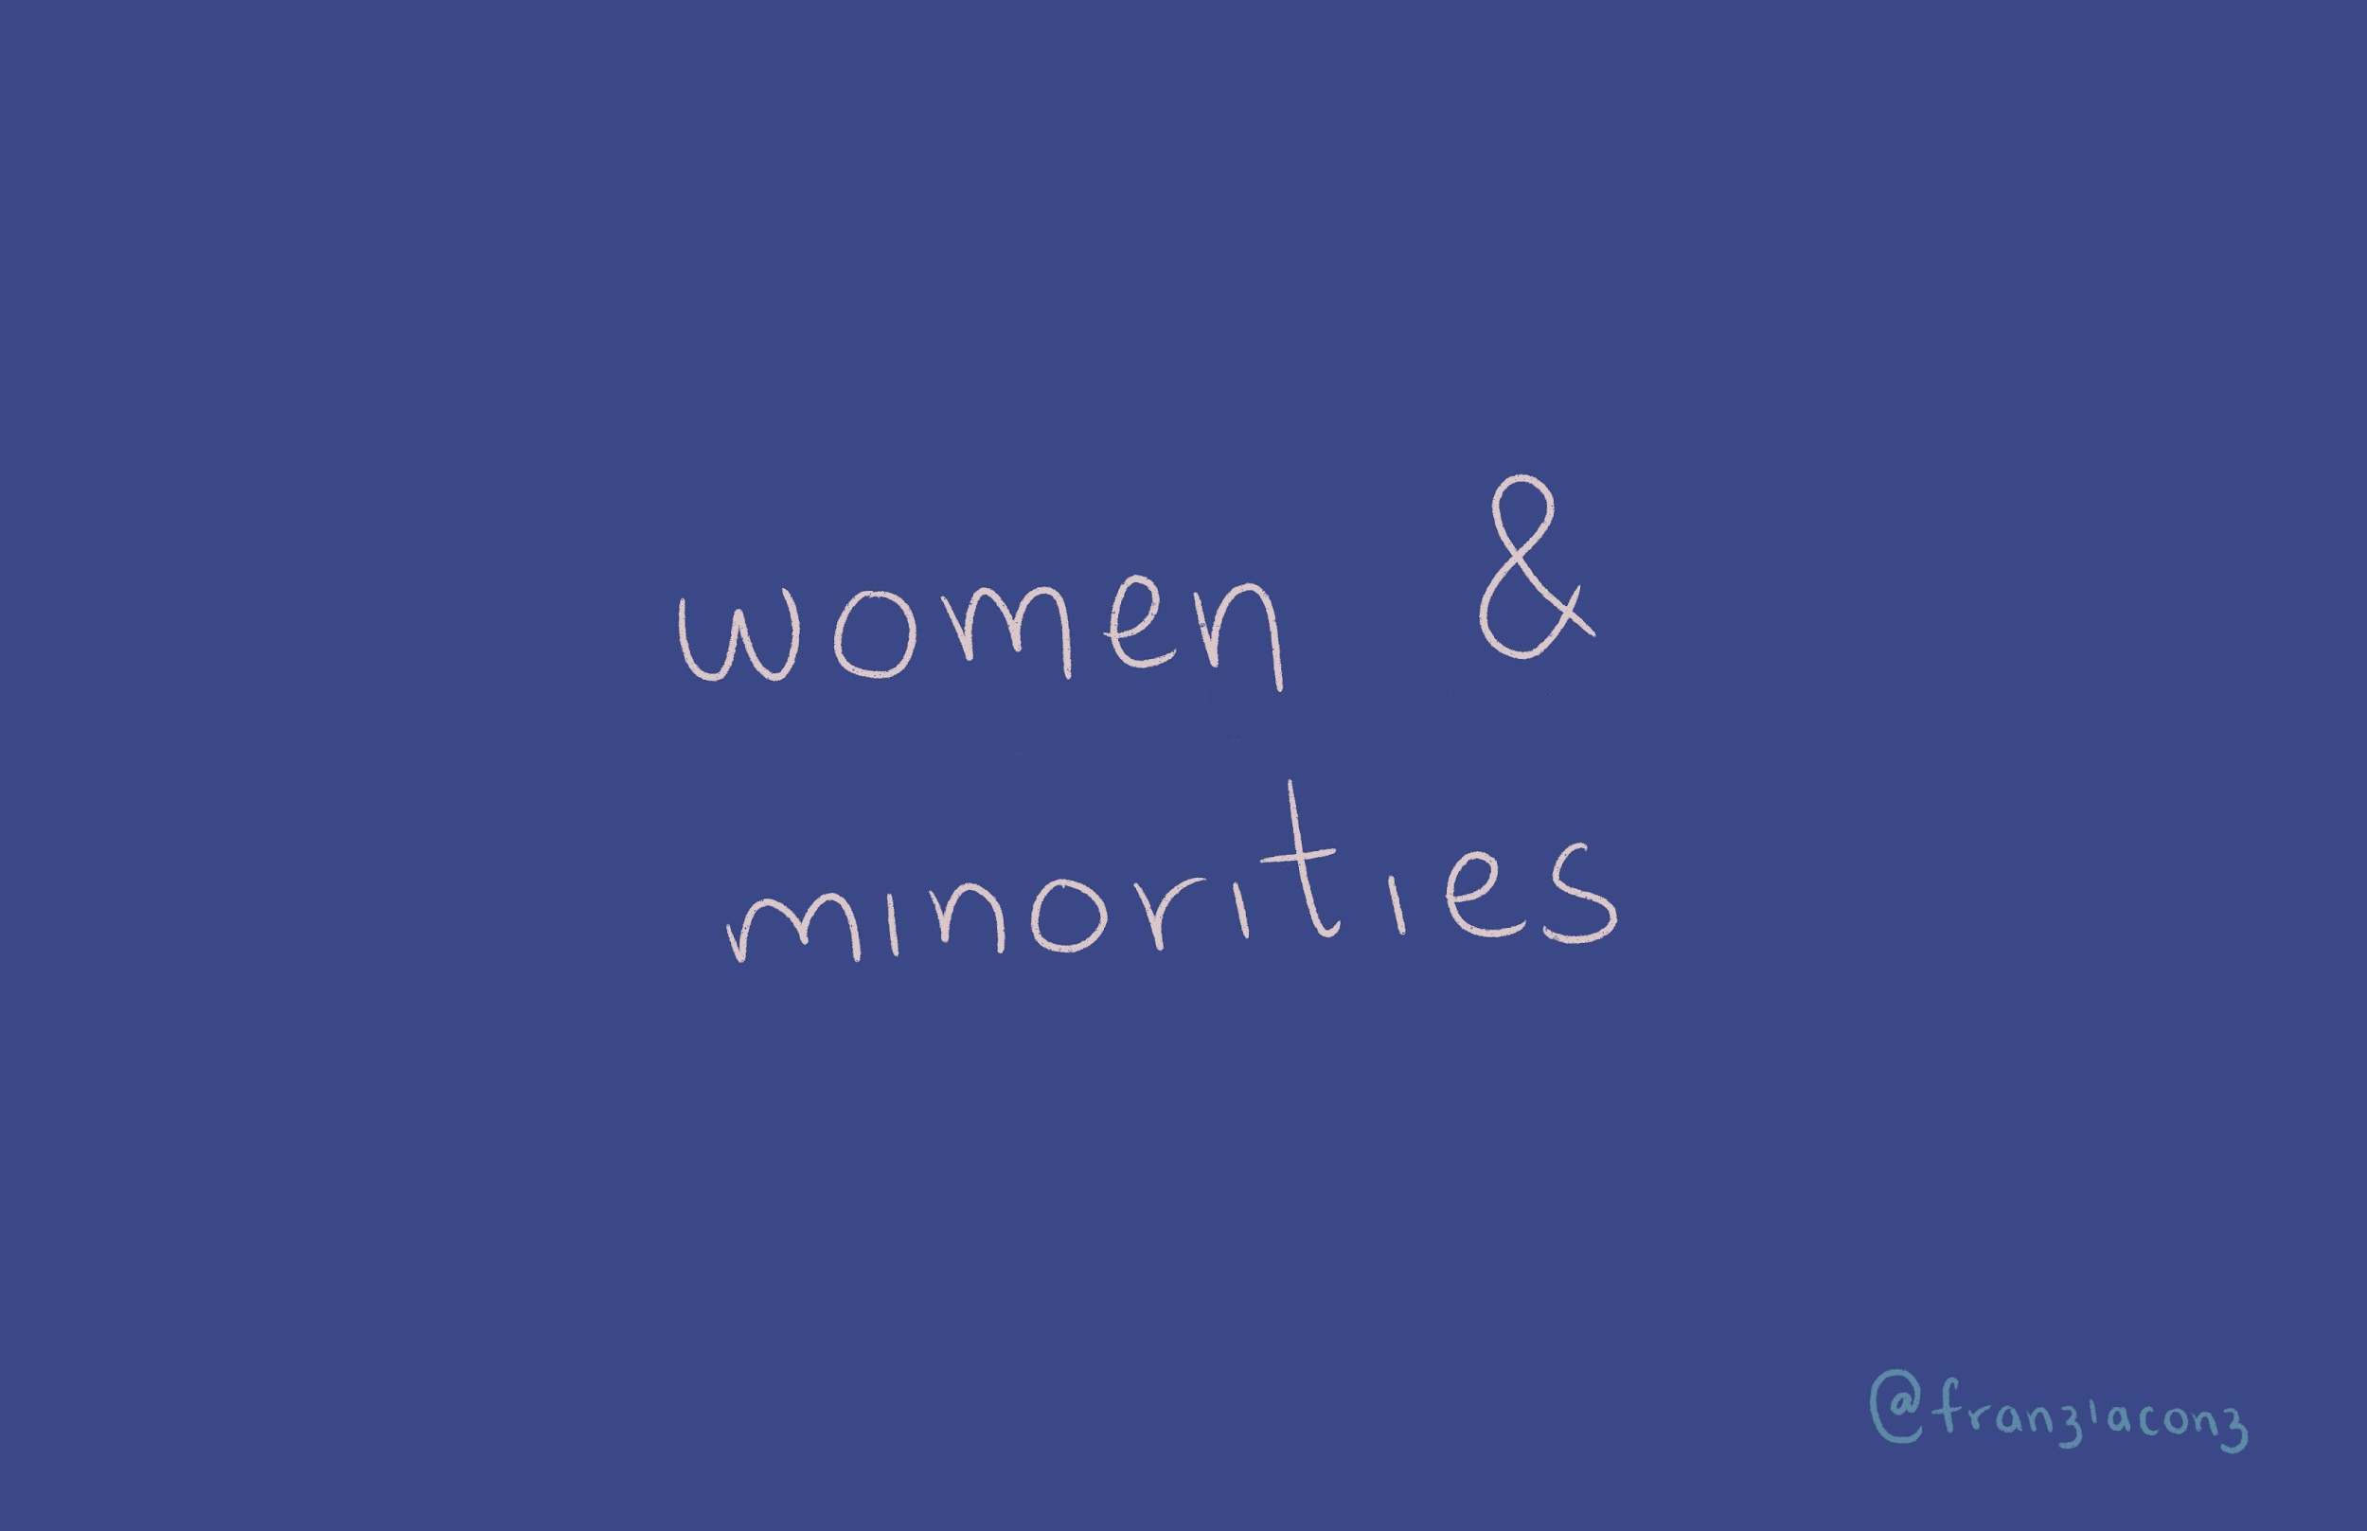

Slide 12
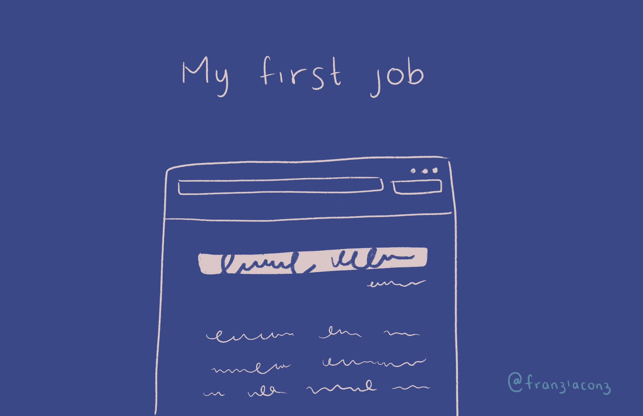

Slide 13
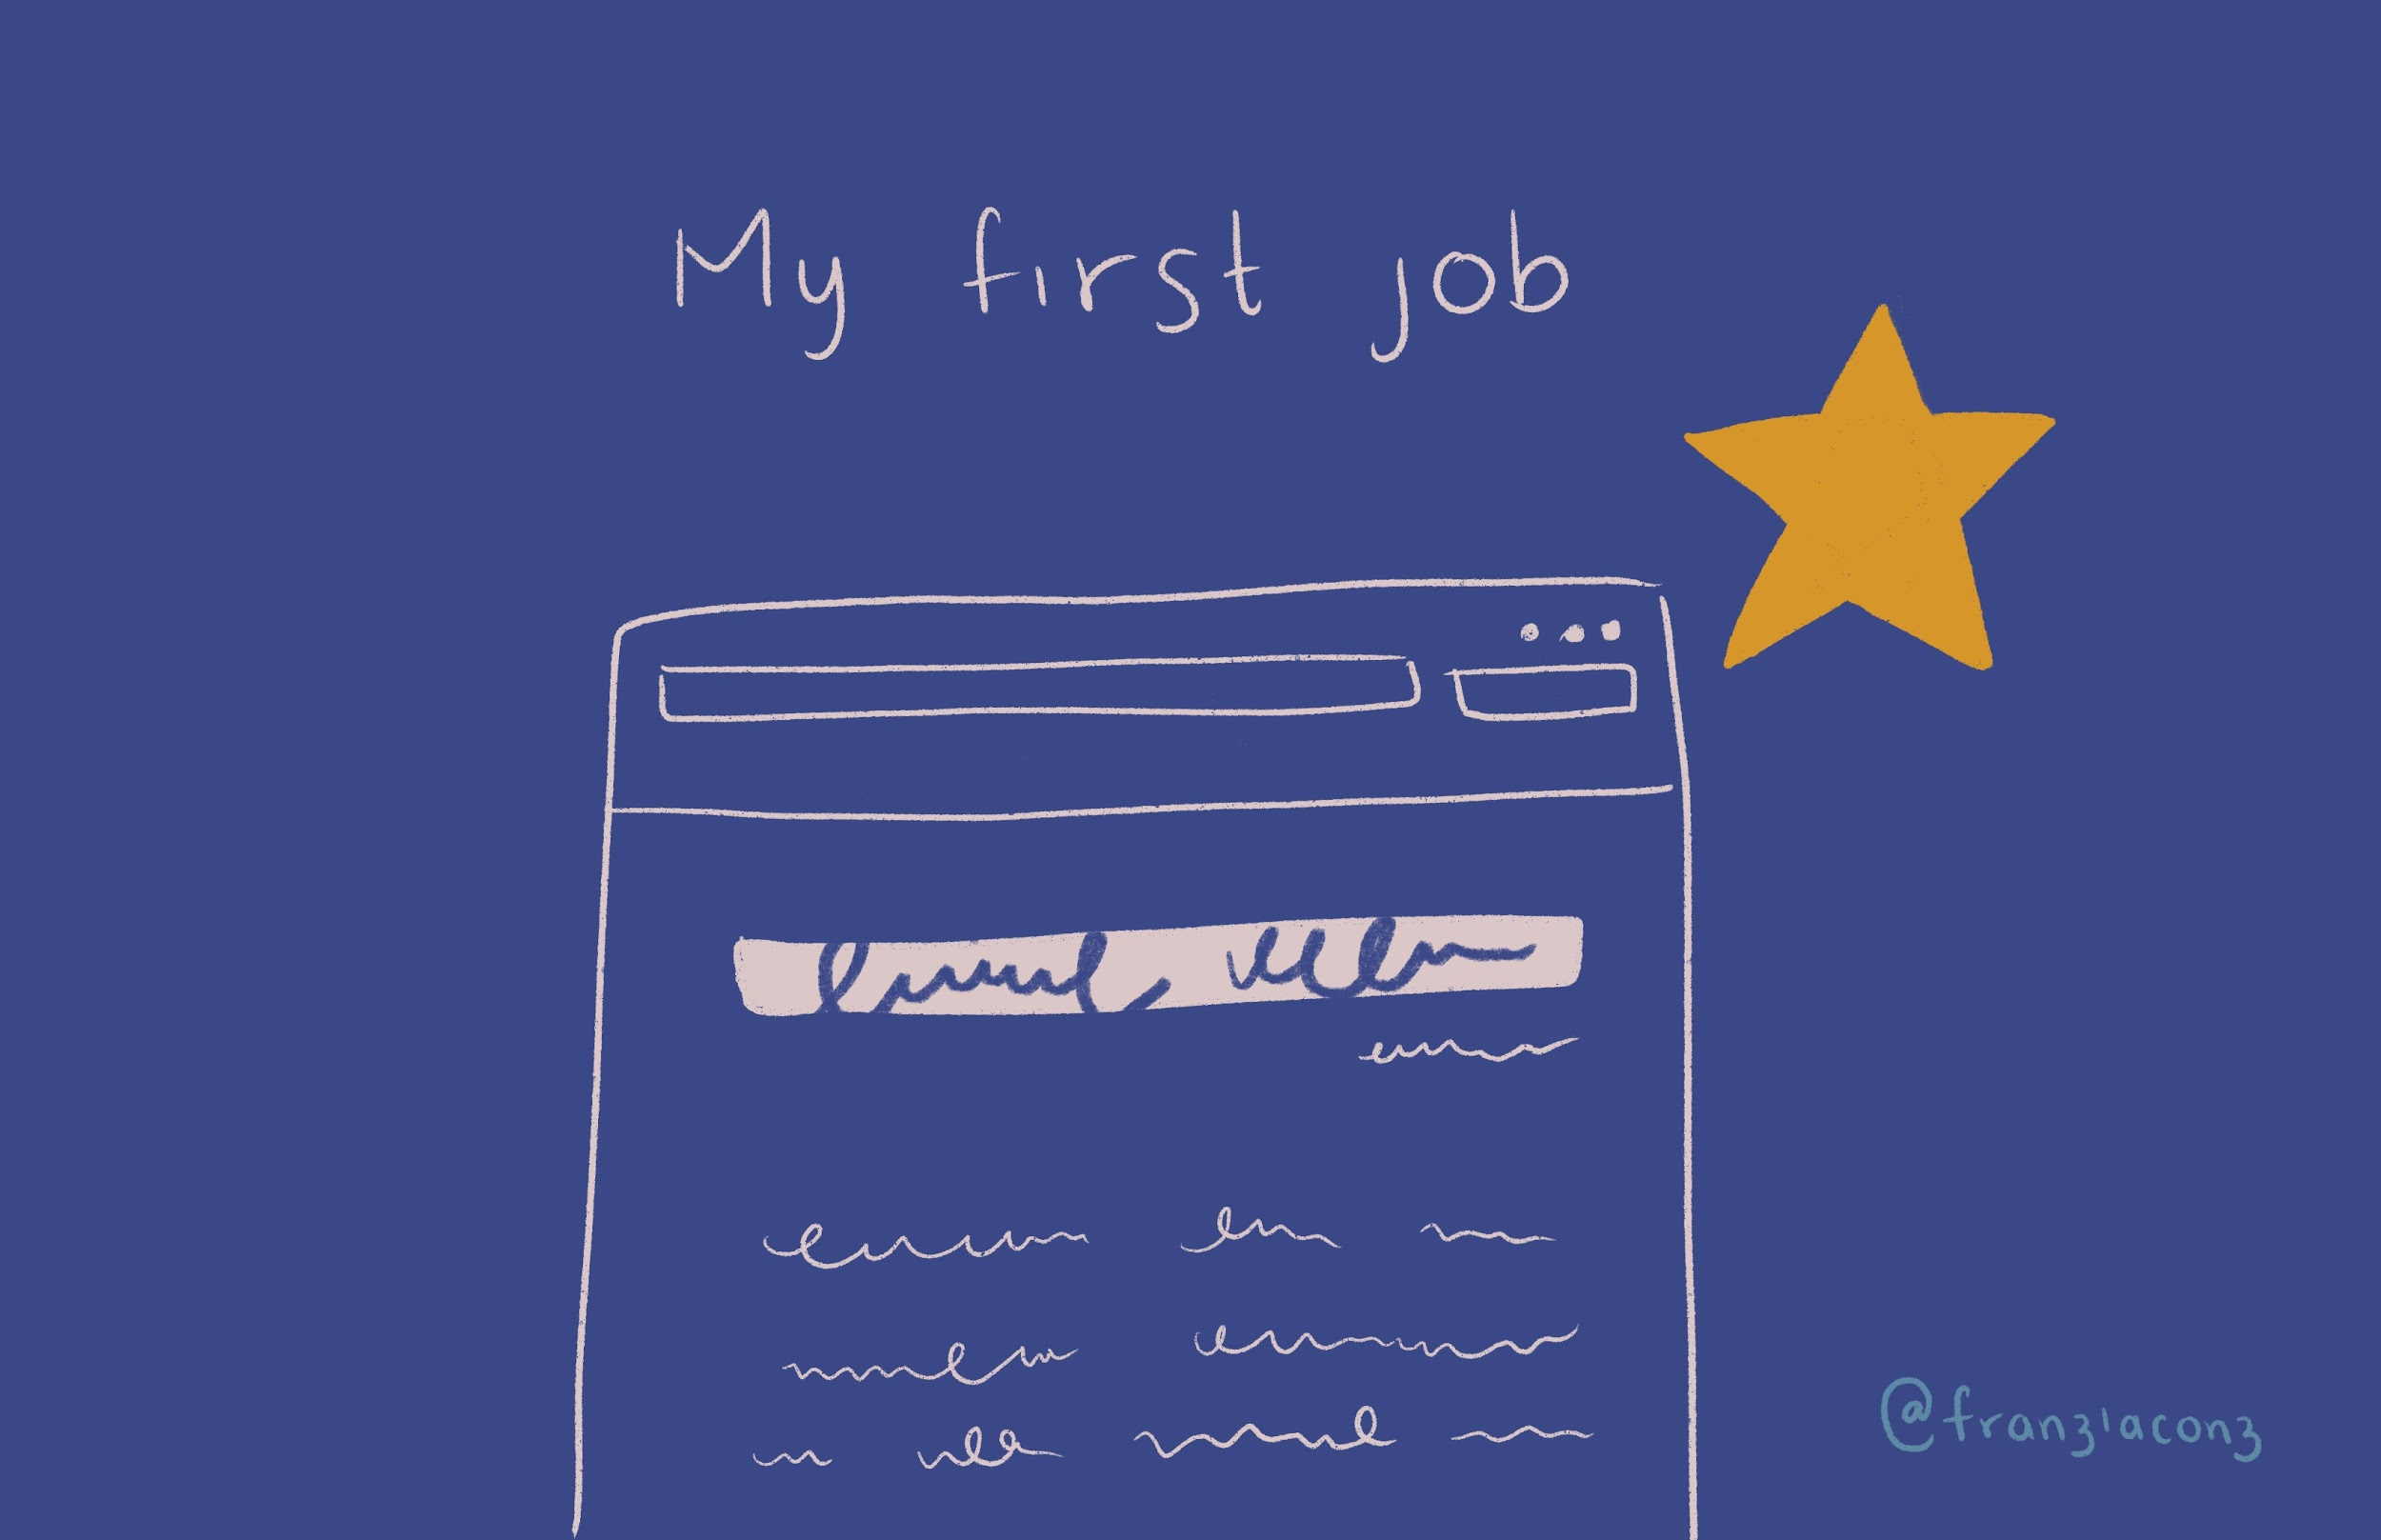

Slide 15
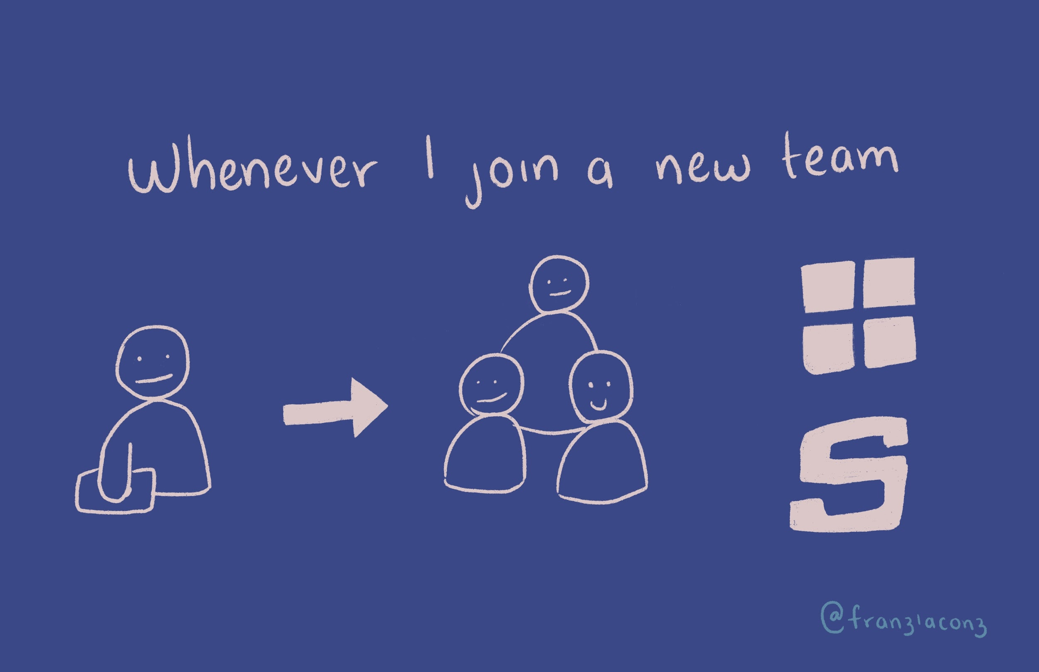

Slide 16
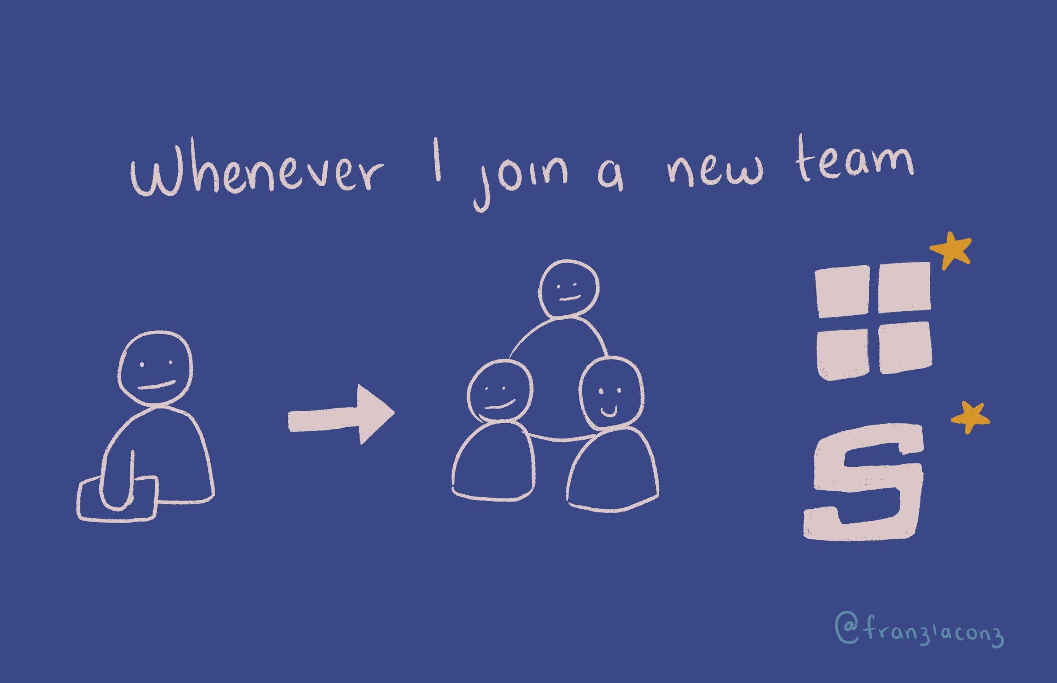

Slide 18
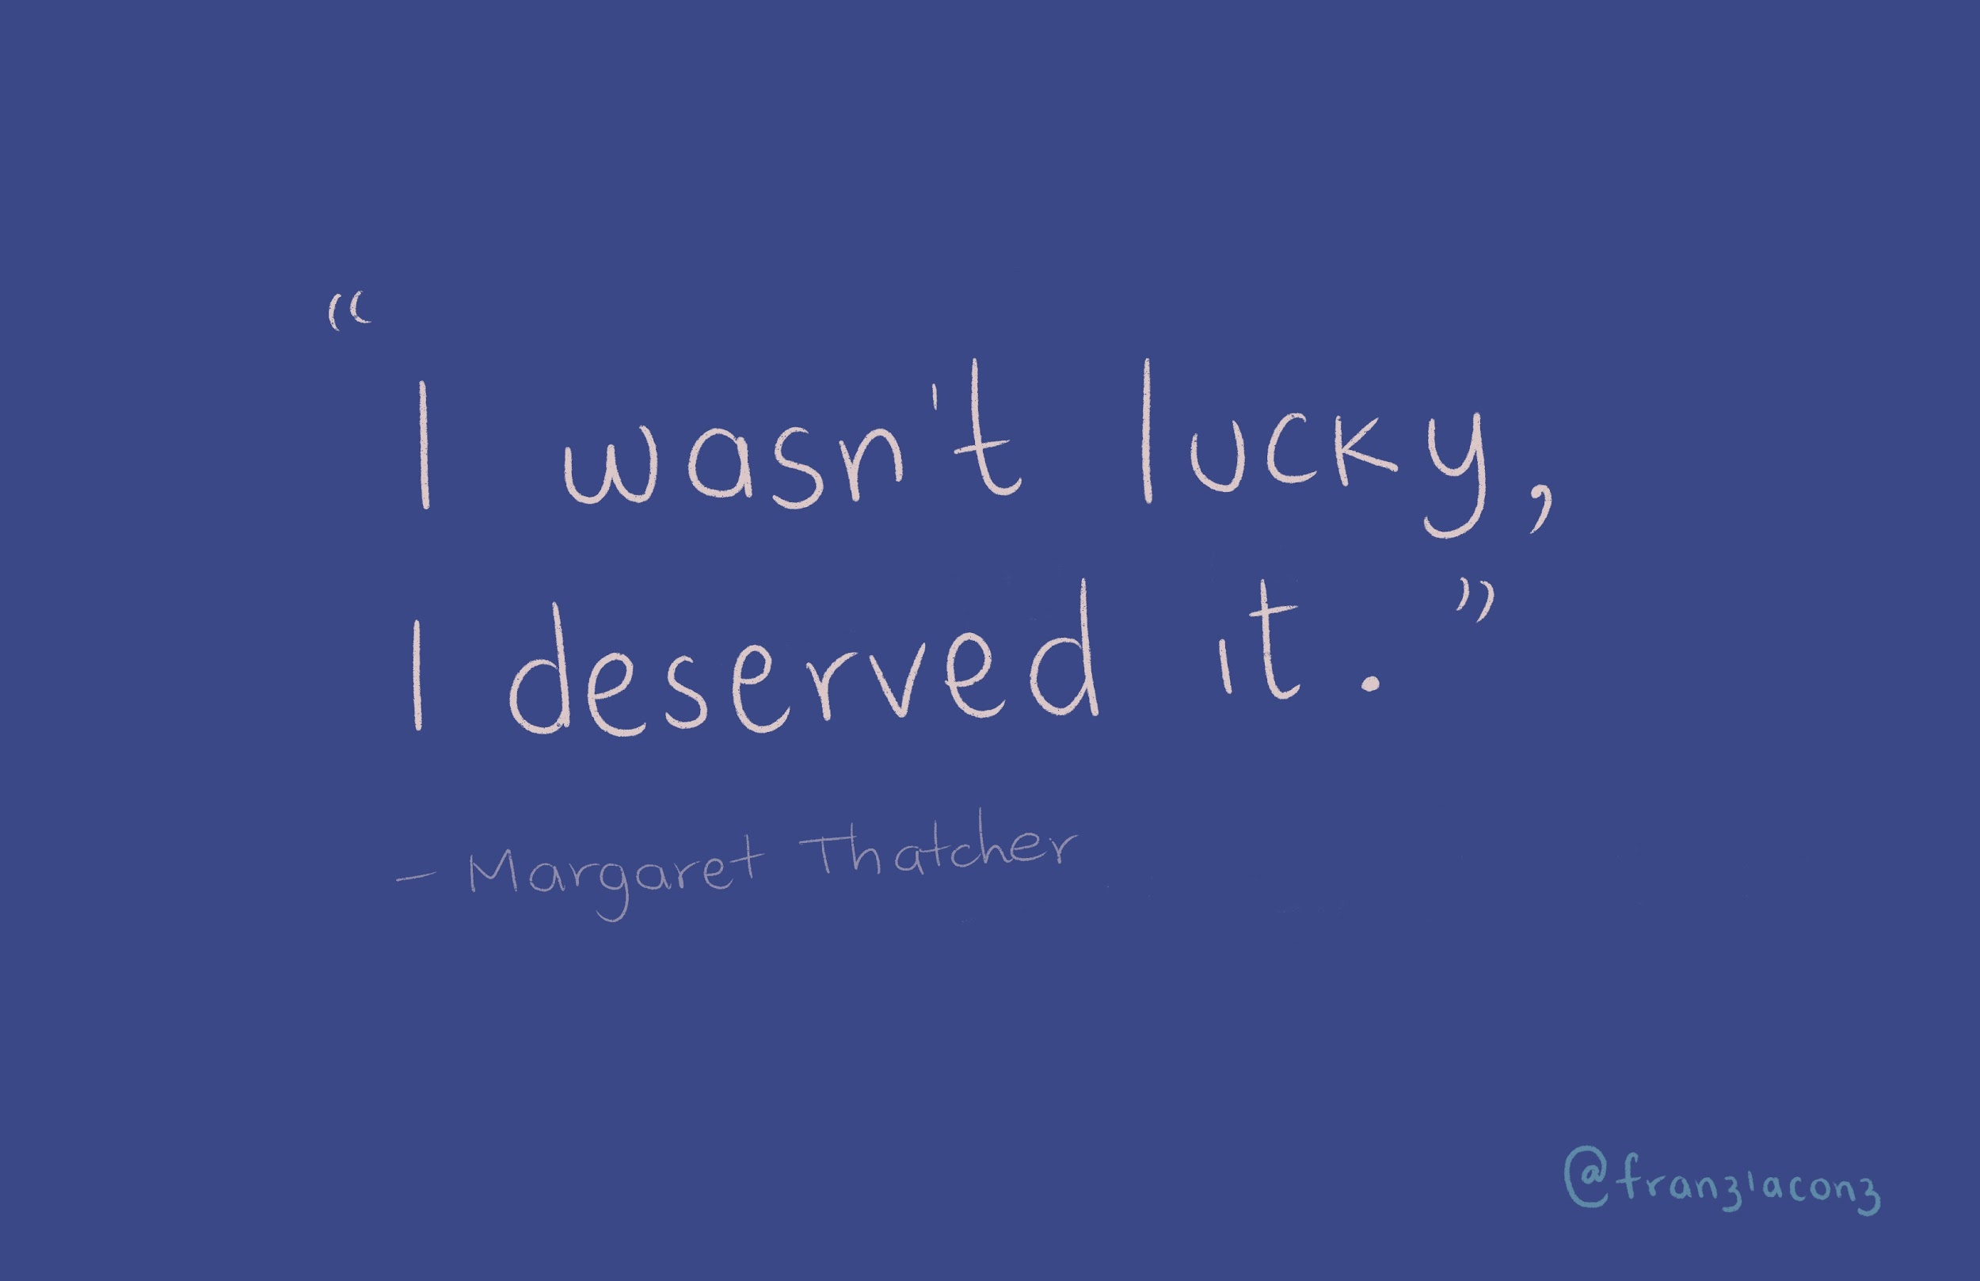

Slide 20
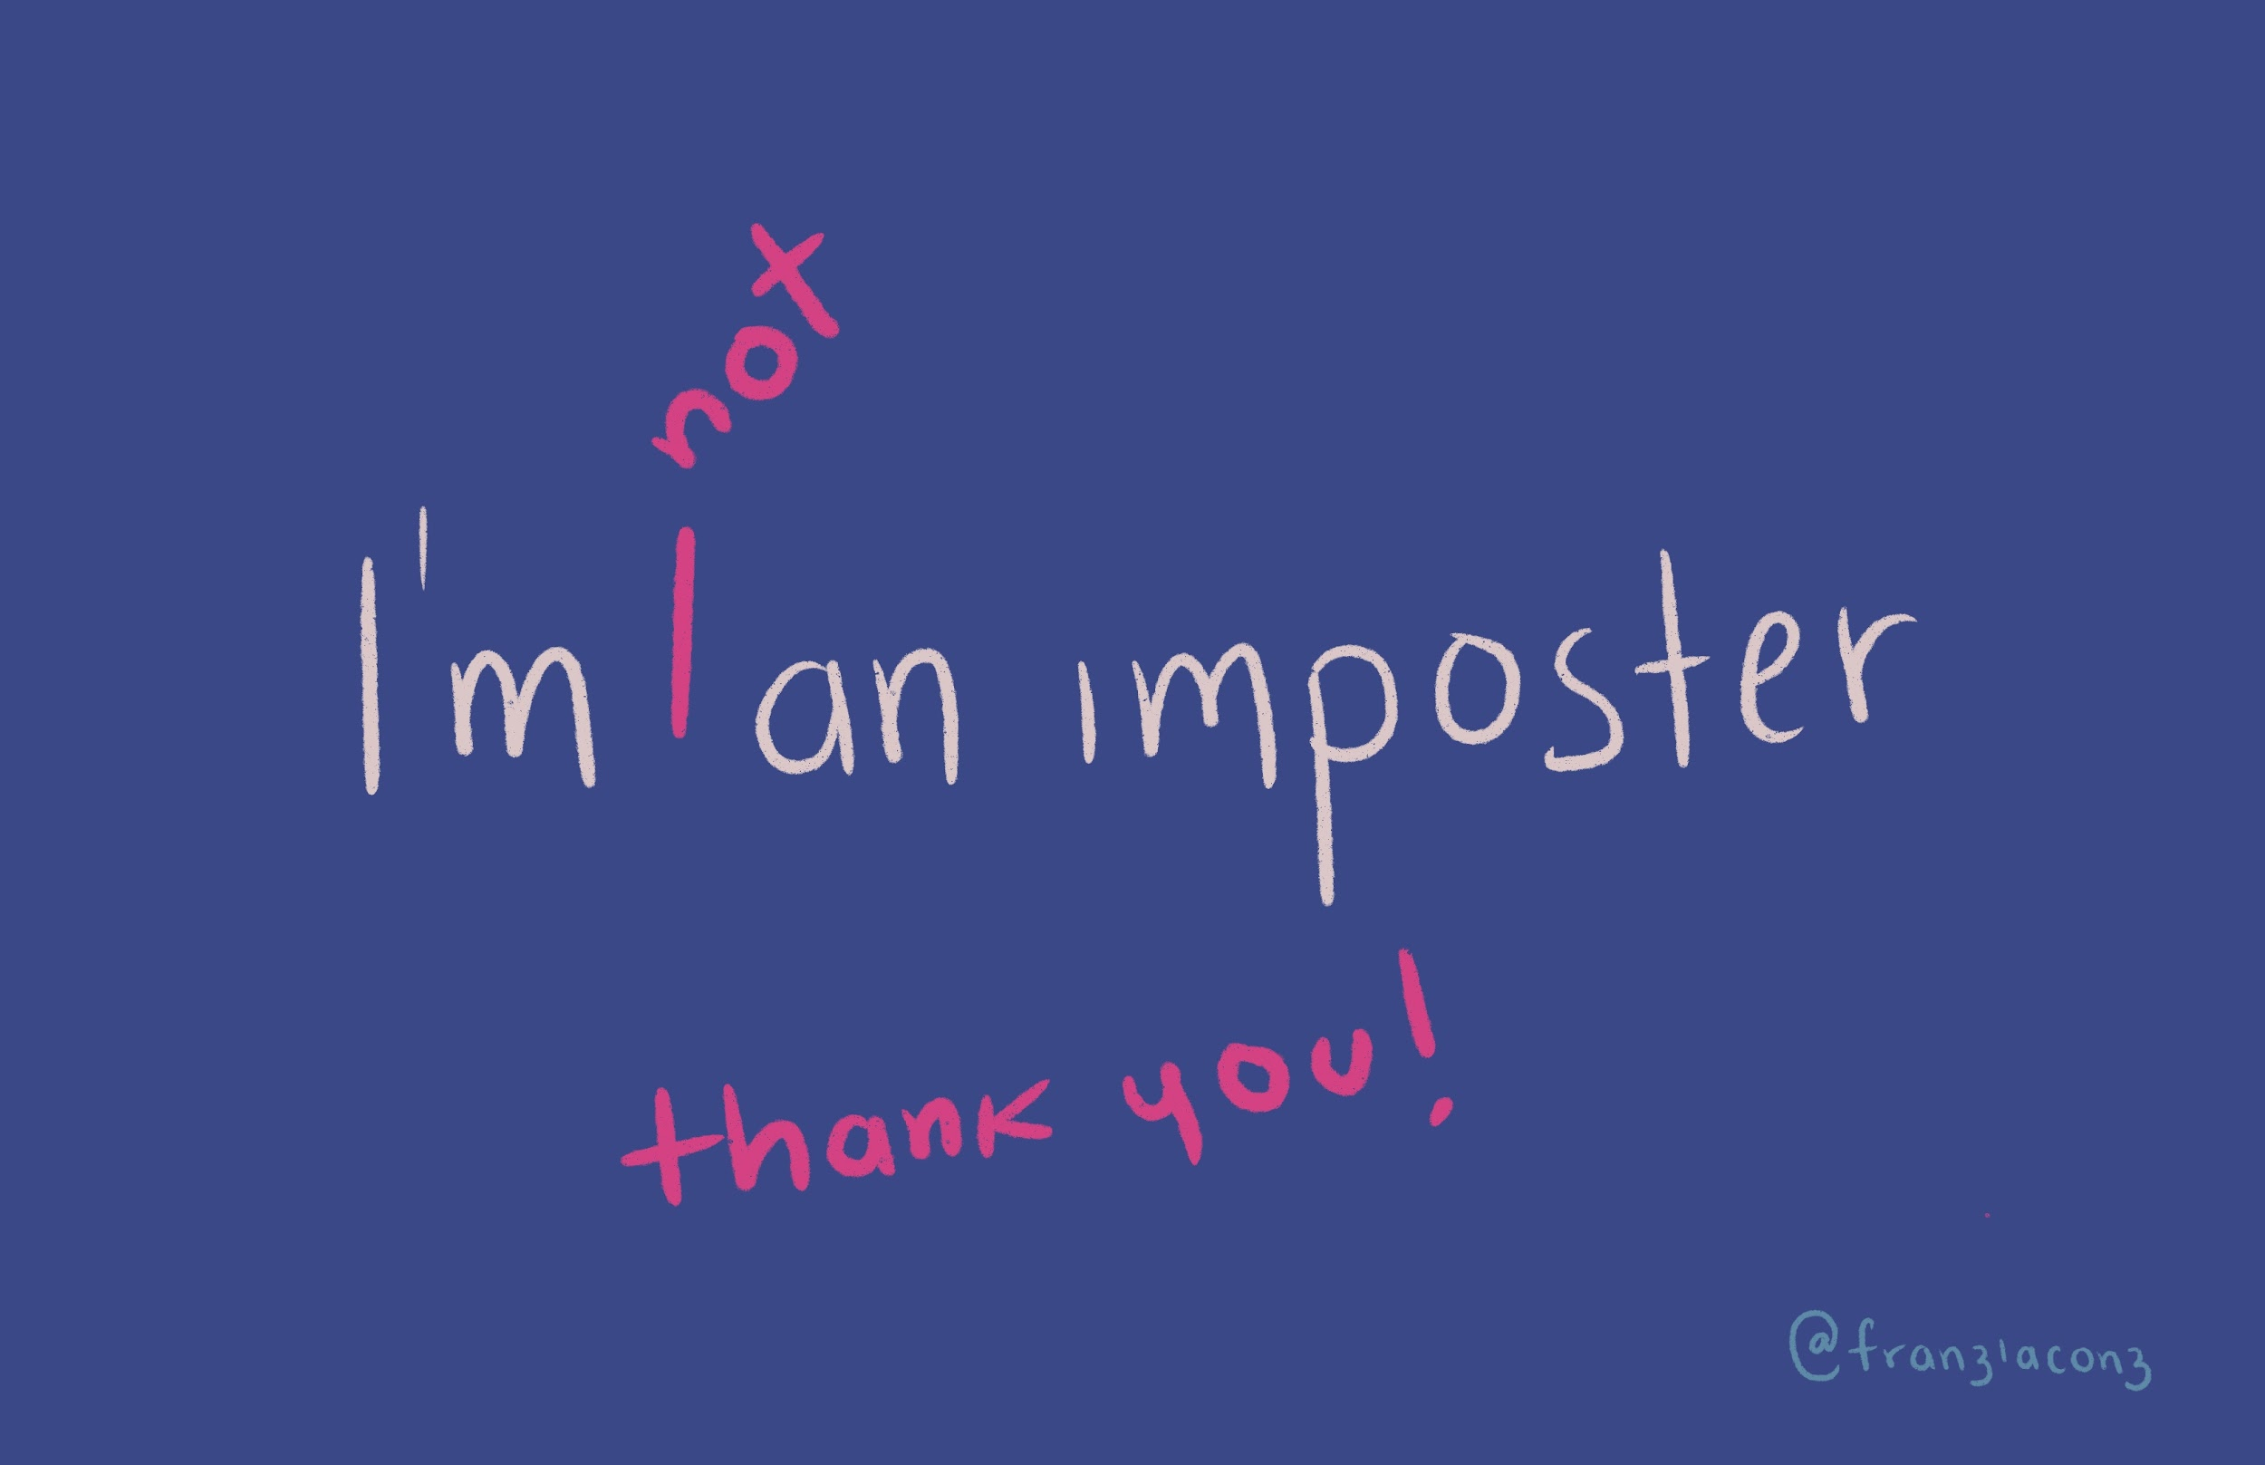

Slide 21
Appendix
Mayuko https://www.youtube.com/watch?v=DYPdsCN69lc
Mental Health Awareness: https://www.teamblind.com/blog/index.php/2020/07/22/impostor-syndrome-tech-and-finance-professionals-are-not-immuned/
Michelle Obama https://www.youtube.com/watch?v=dumm_XfHkmY
Jessica Rose, Laracon 2015 https://www.youtube.com/watch?v=wtrF5C7Gv7E

